Slide 1
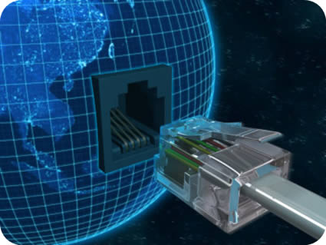
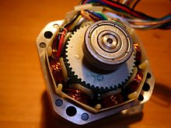
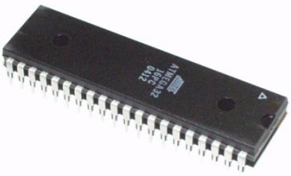

Microcontroller-based Stepper motor Control System with Computer-based User Interface(UI) and Internet-Control Accessibility For Remote Control
Submitted by :
Raziur Rahman
Rashed Hasan Bipu
Saugato Rahman Dhruba
Abul Hasan Fahad
Monjurul Feroz Meem

Slide 2
This presentation is divided into 5 parts
Main Idea
Introduction to components
3.Operation
4. Cost Analysis
5. Achievements

Slide 3
Main Idea

Slide 4
The total operation is described in the following block diagram
Computer-based
User Interface
(a software)
Micro-controller based
controller circuit
Stepper
Motor

Slide 5
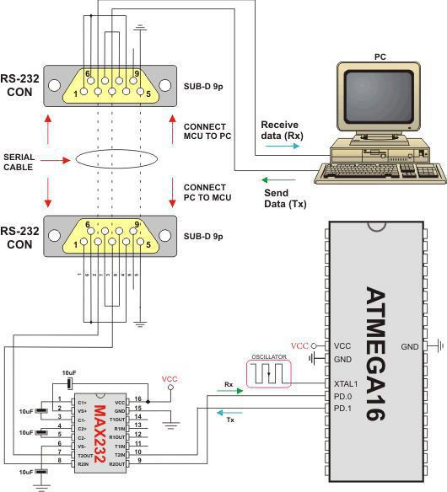
Graphical Representation of Block Diagram

Slide 6
Flow chart of
Remote
Motor Control
Via. Internet
Giving Command
from a website
Command travelling
Through internet
Command recognized from
Pre-recognized URL by the main
software
Operating signal transmits
Necessary command to Microcontroller
Via Serial Communication link
Motor gets controlled

Slide 7
Go to
Mytextfile.com
How to operate using Internet
Signing in
with a
Google account
Give Command
from
Mytextfile.com
(Computer or mobile)
Motor control
accomplished
Command goes to
microcontroller
circuit
via Serial communication Port
(USB-to-Serial Conversion and RS-232)
Command recognized
by the
Central computer
Software

Slide 8
What is actually needed?
Stepper Motor
Micro-controller
Computer-based User Interface
Internet Connectivity (Only for Remote control)
USB-to-Serial Converter
Computer or mobile phone for Remote control
Five volt supply

Slide 9
Introduction
of
Different Components

Slide 10
Stepper Motor
A stepper motor (or step motor) is a brushless DC electric motor that divides a full rotation into a number of equal steps. The motor's position can then be commanded to move and hold at one of these steps without any feedback sensor (an open-loop controller), as long as the motor is carefully sized to the application.
There are four main types of stepper motors:[
Permanent magnet stepper (can be subdivided into 'tin-can' and 'hybrid', tin-can being a cheaper product, and hybrid with higher quality bearings, smaller step angle, higher power density)
Hybrid synchronous stepper
Variable reluctance stepper
Lavet type stepping motor

Slide 11
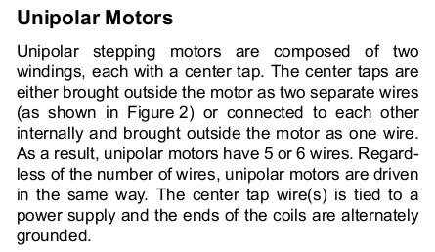
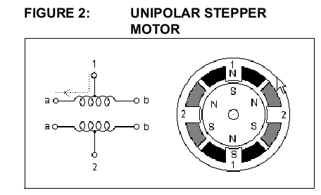
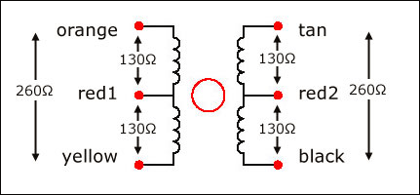

Slide 12
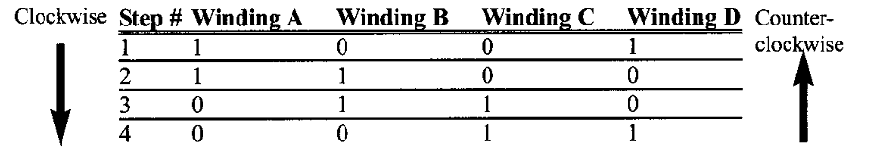
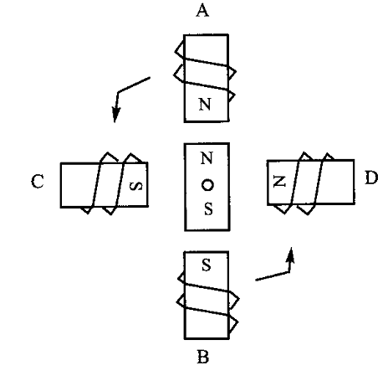

Slide 13

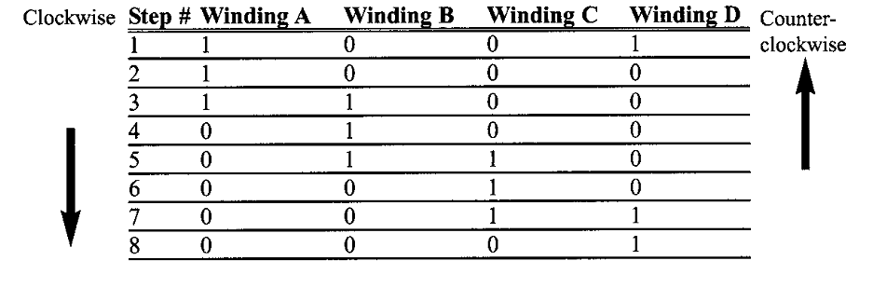

Slide 15
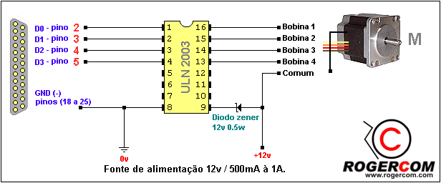
This IC is here to provide extra current necessary to drive the motor. It supplies current necessary to excite the motor windings.
Pins from
Microcontroller
Motor, requiring high current

Slide 16
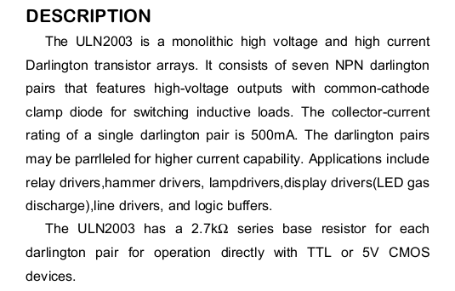
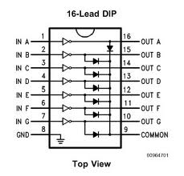

Slide 17
Animation of Interfacing ULN-2003 and Stepper Motor (unipolar)

Slide 18
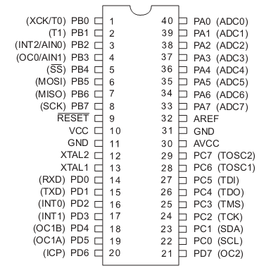

Slide 19
Features
• High-performance, Low-power AVR 8-bit Microcontroller
• Advanced RISC Architecture
– 131 Powerful Instructions – Most Single-clock Cycle Execution
– 32 x 8 General Purpose Working Registers
– Fully Static Operation
– Up to 16 MIPS Throughput at 16 MHz
– On-chip 2-cycle Multiplier
• Nonvolatile Program and Data Memories
– 32K Bytes of In-System Self-Programmable Flash
– Optional Boot Code Section with Independent Lock Bits, In-System Programming by On-chip Boot Program , True Read-While-Write Operation
– 1024 Bytes EEPROM
Endurance: 100,000 Write/Erase Cycles
– 2K Byte Internal SRAM
– Programming Lock for Software Security

Slide 20
Peripheral Features of ATmega32
– Two 8-bit Timer/Counters with Separate Pre-scalers and Compare Modes
– One 16-bit Timer/Counter with Separate Pre-scaler, Compare Mode, and Capture Mode
– Real Time Counter with Separate Oscillator
– Four PWM Channels
– 8-channel, 10-bit ADC
– Byte-oriented Two-wire Serial Interface
– Programmable Serial USART
– Master/Slave SPI Serial Interface
– Programmable Watchdog Timer with Separate On-chip Oscillator
– On-chip Analog Comparator

Slide 21
Other Features of ATmega32
• I/O and Packages
– 32 Programmable I/O Lines
– 40-pin PDIP, 44-lead TQFP, and 44-pad MLF
• Operating Voltages
– 2.7 - 5.5V for ATmega32L
– 4.5 - 5.5V for ATmega32
• Speed Grades
– 0 - 8 MHz for ATmega32L
– 0 - 16 MHz for ATmega32
• Power Consumption at 1 MHz, 3V, 25°C for ATmega32L
– Active: 1.1 mA
– Idle Mode: 0.35 mA
– Power-down Mode: < 1 µA

Slide 22
Ports in Atmega32
Each port pin in AVR ATmega32 consists of three register bits: DDxn, PORTxn, and PINxn.
The DDxn bits are accessed at the DDRx I/O address, the PORTxn bits at the PORTx I/O address, and the PINxn bits at the PINx I/O address.
The DDxn bit in the DDRx Register selects the direction of this pin. If DDxn is written logic one, Pxn is configured as an output pin. If DDxn is written logic zero, Pxn is config-ured as an input pin.
If PORTxn is written logic one when the pin is configured as an input pin, the pull-up resistor is activated. To switch the pull-up resistor off, PORTxn has to be written logic zero or the pin has to be configured as an output pin. The port pins are tri-stated when a reset condition becomes active, even if no clocks are running.
If PORTxn is written logic one when the pin is configured as an output pin, the port pin is driven high (one). If PORTxn is written logic zero when the pin is configured as an out-put pin, the port pin is driven low (zero).

Slide 23
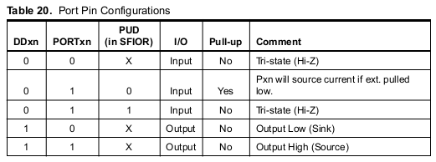
PORT PIN CONFIGURATIONS

Slide 24
Serial Vs. Parallel Communication
Although a serial link may seem inferior to a parallel one, since it can transmit less data per clock cycle, it is often the case that serial links can be clocked considerably faster than parallel links in order to achieve a higher data rate.
In many cases, serial is a better option because it is cheaper to implement. Many ICs have serial interfaces, as opposed to parallel ones, so that they have fewer pins and are therefore less expensive.

Slide 25
USB-to-Serial Conversion
What is RS-232
What is USB
Universal Serial Bus (USB) is an industry standard developed in the mid-1990s that defines the cables, connectors and communications protocols used in a bus for connection, communication and power supply between computers and electronic devices. It was invented by Ajay Bhatt.
USB was designed to standardize the connection of computer peripherals, such as keyboards, pointing devices, digital cameras, printers, portable media players, disk drives and network adapters to personal computers, both to communicate and to supply electric power. It has become commonplace on other devices, such as smartphones, PDAs and video game consoles. USB has effectively replaced a variety of earlier interfaces, such as serial and parallel ports, as well as separate power chargers for portable devices.
In telecommunications, RS-232 is the traditional name for a series of standards for serial binary single-ended data and control signals connecting between a DTE (Data Terminal Equipment) and a DCE (Data Circuit-terminating Equipment). It is commonly used in computer serial ports. The standard defines the electrical characteristics and timing of signals, the meaning of signals, and the physical size and pinout of connectors. The current version of the standard is TIA-232-F Interface Between Data Terminal Equipment and Data Circuit-Terminating Equipment Employing Serial Binary Data Interchange, issued in 1997.

Slide 26
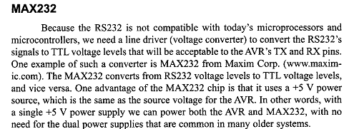
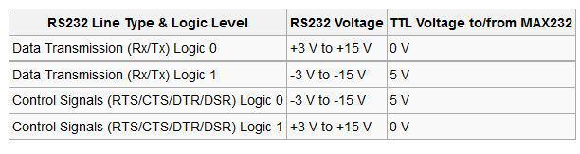

Slide 27
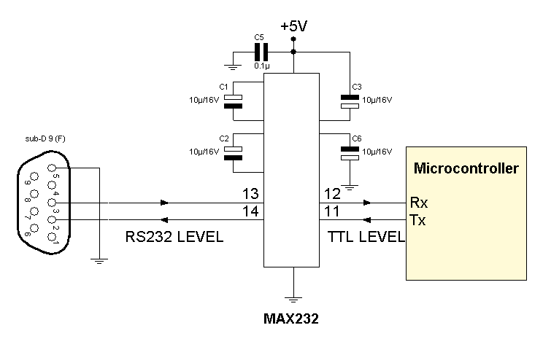
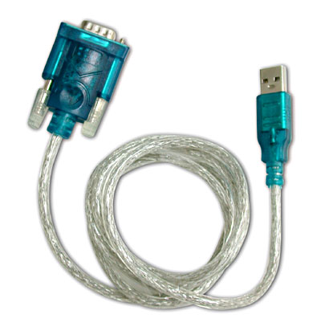
Interfacing Serial Port with Microcontroller

Slide 28
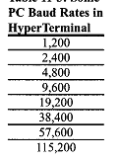


Slide 29
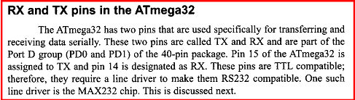

Slide 30
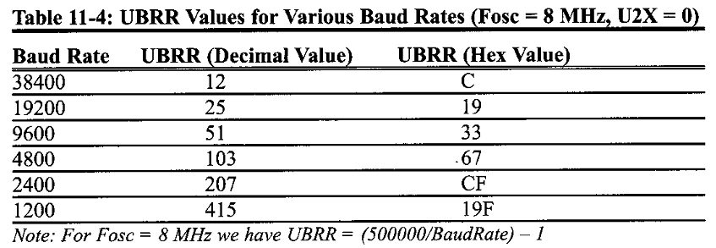
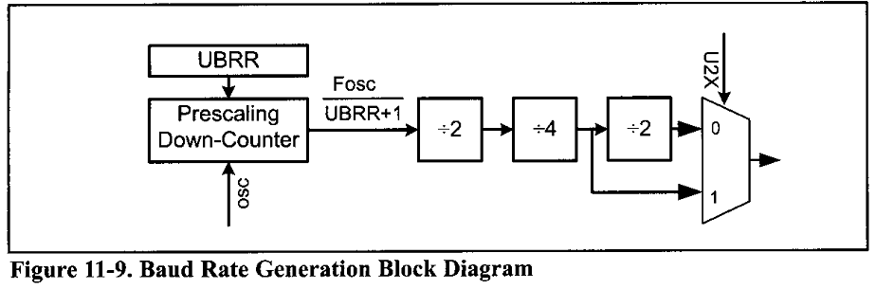

Slide 31
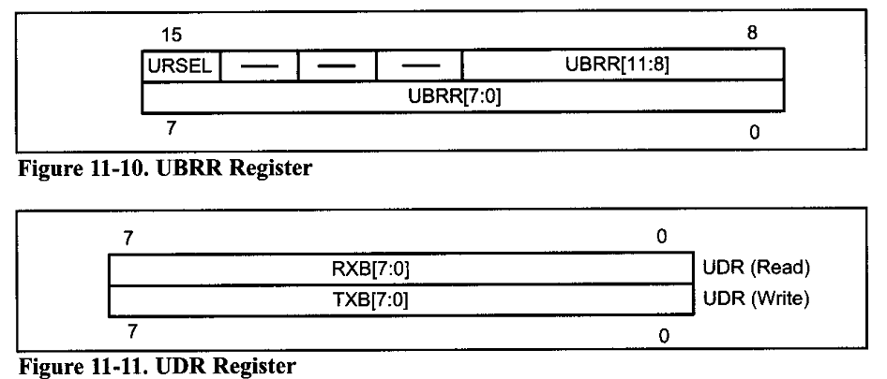

Slide 32
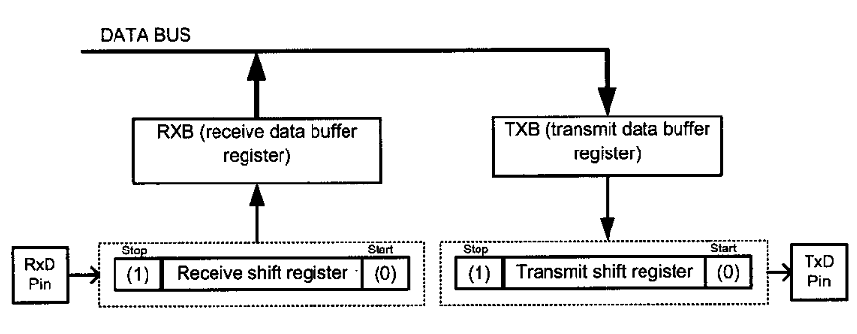

Slide 33
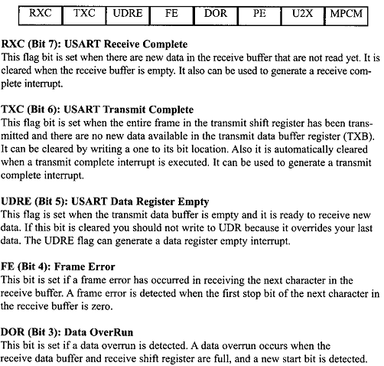

Slide 34
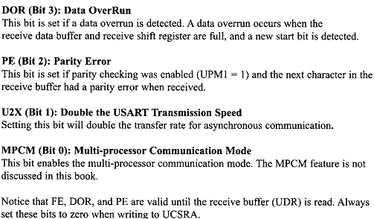

Slide 35
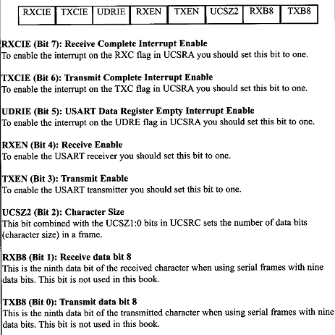

Slide 36
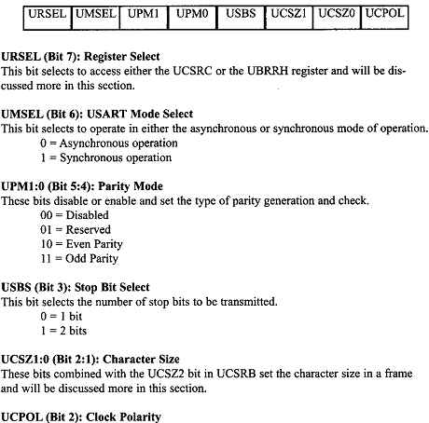

Slide 37
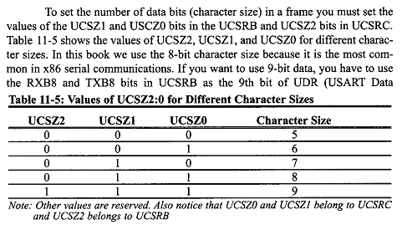

Slide 38
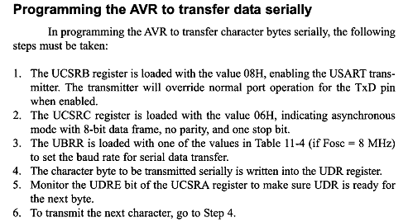

Slide 39
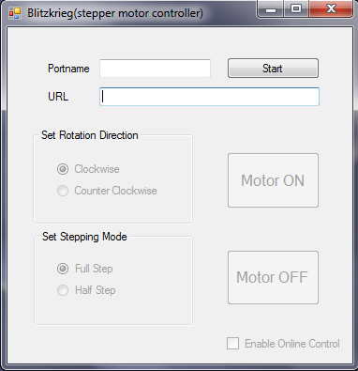
USER INTERFACE DEVELOPED BY C# Programming Language

Slide 40
Features of USER INTERFACE

Slide 41
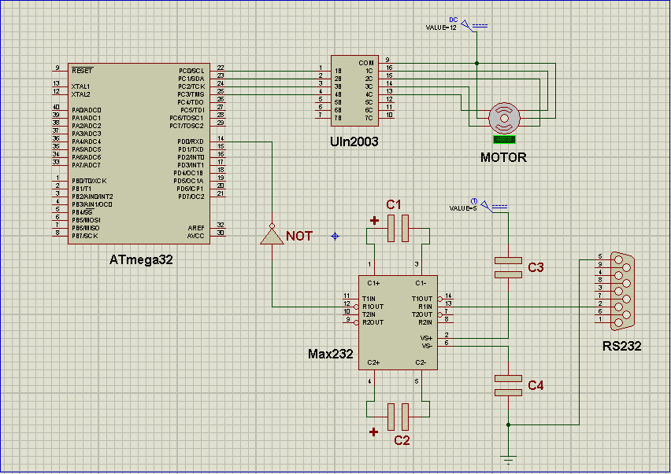
Final
Circuit
Diagram

Slide 42
Operation: Step-by-Step
Step 0:
Install the Prolific PL-2303 vista driver. Connect the cable to the
USB port when asked. (This step is needed to be done only when
the device is connected to the PC for the very first time.)
Step 1:
Reconnect the cable. Go to ‘Device Manager’ and take note of the
newly added port’s name under ‘Ports’. It should be ‘COMX’ (X
may be any number like 1, 2, 3 etc) and can be found inside the
Parenthesis.
Step 2:
Power the device via a 2 pin plug.

Slide 43
Step 4:
Click Start.
Step 4:
Click Start.
Operation: Step-by-Step
Step 3:
Open the program ‘Blitzkrieg (stepper motor controller)’. Type the
port’s name you have noted in step 2 in the ‘Portname’ textbox.
(The name MUST be written in capital letter.)
Step 4:
Click “Start”
Step 5:
Click the exit cross to exit the program.

Slide 44
Extra Feature: Control via Internet
For this you need a stable internet connection to the PC which will be used to operate the device. Follow the previously stated steps 1, 2 and 3.
Extra Feature: Control via Internet
For this you need a stable internet connection to the PC which will be used to operate the device. Follow the previously stated steps 1, 2 and 3.
Extra Feature: Control via Internet
For this you need a stable internet connection to the PC which will be used to operate the device. Follow the previously stated steps 1, 2 and 3.
Extra Feature: Control via Internet
For this you need a stable internet connection to the PC which will be
used to operate the device. Follow the previously stated steps 1, 2 and 3.
Step 4:
Open the internet browser of the PC/ Cell phone/ Tablet PC by
which you want to control the stepper motor.
Go to www.mytextfile.com
Step 5:
Sign in with your Gmail/ Google account.
Step 6:
Click ‘Settings’. Tick the checkbox beside ‘Publish text file to secret private URL:’. Click ‘Save Settings’.

Slide 45
Extra Feature: Control via Internet
Step 7:
Again go to Settings and you will find a URL beside ‘Publish text file to
secret private URL:’. Copy the URL to the ‘URL’ textbox of the
‘Blitzkrieg (stepper motor controller)’ program opened previously in
the PC connected with our device.
Step 8:
Click Start and then Tick the checkbox beside ‘Enable Online Control’.
Now we can start controlling the stepper motor via internet.

Slide 46
Extra Feature: Control via Internet
Step 9:
On the www.mytextfile.com site you will find a text editor window.
Here if you write a key-letter and then click ‘Save’ the motor will act
accordingly. The key-letters are-
‘A’ for clockwise full step rotation
‘B’ for clockwise half step rotation
‘C’ for anti-clockwise full step rotation
‘D’ for anti-clockwise half step rotation
‘O’ for Motor Off
Remember, there must be only one letter and it must be written at
the first position of the text editor. Also, the key-letter is to be written
in Capital.

Slide 47
Cost
Name of the Component | Price(BTD)
1.Transformer | 120
2.Bridge rectifier | 40
3.7805IC | 7
4.Heat sink | 35
5.RS232 Connector | 250
6.RS232 Male-female cable | 200
7.MAX 232 | 65
8.ATMEGA 32 | 385
9.Stepper Motor | 230
10.ULN 2003 | 23
11.Capacitors(8 piece) | 25
12.Wire | 30
13.Bread Board(2 piece) | 300(150*2)
Total
1710

Slide 48
Achievements
Thorough Idea of Microcontroller Programming
Developing System Using Microcontroller
Application of Stepper Motor in Practical purpose
Idea of remote-control of systems using Internet
Learning C# programming Language
Team Work

